Slide 1
MANUFACTURING
Part 1
Notes:
What is mfg day
Let’s talk about why you are all here today, mfg day
?: Does anyone know what mfg is all about?
AP-
Mfg day is an annual event held in Oct where U.S. mfgs like Haas open their doors to demonstrate what modern mfg is all about

Slide 2
what is
MANUFACTURING?
Notes:
What is mfg day
Let’s talk about why you are all here today, mfg day
?: Does anyone know what mfg is all about?
AP-
Mfg day is an annual event held in Oct where U.S. mfgs like Haas open their doors to demonstrate what modern mfg is all about

Slide 3
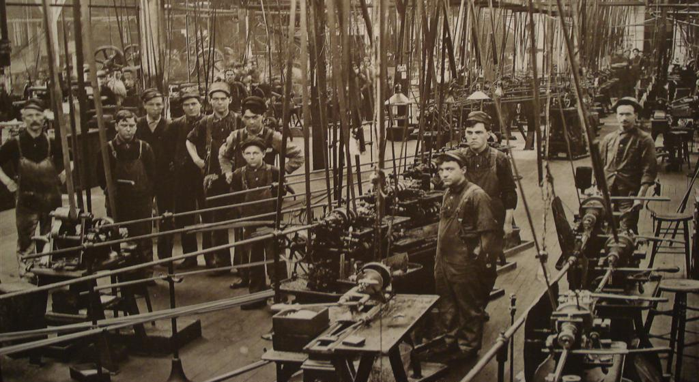
the disconnect between
PERCEPTIONS & FACTS
Notes:
Not a modern mfg facility
For example, a lot of people these days still think that factories like this from the turn of the century or early 1900s is what the modern mfg facility is like today

Slide 4
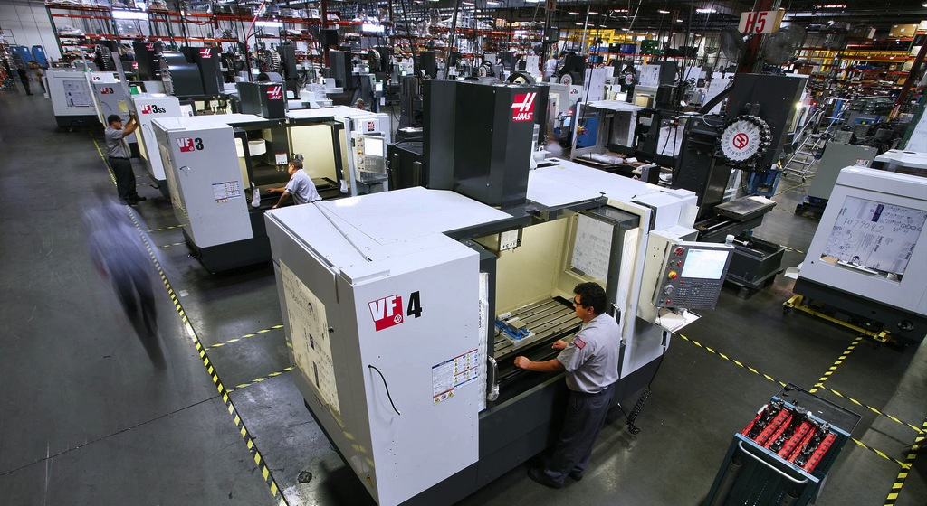
the disconnect between
PERCEPTIONS & FACTS
Notes:
Modern mfg facility
This is actually the reality, modern, advanced mfg facilities like Haas
Clean, safe, use of FMS, lights out, robotics, etc.
We are going to be able to see this live in a few minutes

Slide 5
the reality of
MANUFACTURING in AMERICA
Notes:
Reality of mfg in America
The reality of mfg in America usually surprises a lot of people

Slide 6

the reality of
MANUFACTURING in AMERICA
Largest mfg economy in the world
Notes:
Reality of mfg in America
For one, the U.S. has the largest mfg economy in the world
Everything is not build it China or India contrary to popular belief

Slide 7


the reality of
MANUFACTURING in AMERICA
Largest mfg economy in the world
1 mfg job creates 2.9 jobs in other sectors
Notes:
Reality of mfg in America
Every 1 mfg job creates 2.9 jobs in other sectors
Because mfg is a foundation to build upon, etc

Slide 8


the reality of
MANUFACTURING in AMERICA
Largest mfg economy in the world
1 mfg job creates 2.9 jobs in other sectors
Annual average mfg salary = $77,000
Notes:
Reality of mfg in America
Mfg pays, the annual average mfg salary is $77,000

Slide 9


the reality of
MANUFACTURING in AMERICA
Largest mfg economy in the world
1 mfg job creates 2.9 jobs in other sectors
Annual average mfg salary = $77,000
90% mfg workers have benefits
Notes:
Reality of mfg in America
90% mfg workers have benefits

Slide 10


the reality of
MANUFACTURING in AMERICA
Largest mfg economy in the world
1 mfg job creates 2.9 jobs in other sectors
Annual average mfg salary = $77,000
90% mfg workers have benefits
78% mfg workers get retirement
Notes:
Reality of mfg in America
78% mfg workers get retirement

Slide 11

the reality of
MANUFACTURING in AMERICA
Largest mfg economy in the world
1 mfg job creates 2.9 jobs in other sectors
Annual average mfg salary = $77,000
90% mfg workers have benefits
78% mfg workers get retirement
Notes:
Reality of mfg in America
We can see that the reality of mfg is very different than the misconceptions that many people have
That is why we have a mfg day, and why Haas has opened its doors to help the cause

Slide 12
ventura county
SALARIES by INDUSTRY
Construction
Manufacturing
Agriculture
Education
and Health
Leisure and
Hospitality
Notes:
Mfg pay VC
Here we can see hoe mfg pay compares to other fields in Ventura County
Out of construction, … mfg pays well

Slide 13
what is the
SKILLS GAP?
Notes:
Skills gap
Even with a modern facility like we saw and Haas doing well, Haas is facing something that a lot of employers are facing
That is an inability to find qualified people to come work for us
?: Has anyone heard of the skills gap, anyone know what that is?

Slide 14
what is the
SKILLS GAP?
SKILLS
JOB SEEKERS
HAVE
SKILLS
COMPANIES
WANT
Notes:
Skills gap
The skills gap is simply the difference or gap between skills that potential employees have and the skills that employers want

Slide 15

america’s
SKILLS GAP
600,000 Unfilled mfg positions
Notes:
Skills gap
Right now, there are an estimated 600,000 unfilled mfg positions because of the skills gap

Slide 16


america’s
SKILLS GAP
600,000 Unfilled mfg positions
2020: 10 Million new skilled workers needed
Notes:
Skills gap
It is estimated that in less that 10 years, by 2020, 10 million new skilled workers will be needed
The shortage of skilled workers is exploding because people are not getting the skills needed to keep America running

Slide 17

america’s
SKILLS GAP
600,000 Unfilled mfg positions
2020: 10 Million new skilled workers needed
Current skilled worker
Average age: 56
Years until retirement: 5-15
Notes:
Skills gap
The reason is two part:
The current skilled worker is 56 years old and will be retiring in the next 5-15 years
People are not learning skills to be able to replace these people

Slide 18
what do I need
To start in manufacturing?
Notes:
Skills gap
Even with a modern facility like we saw and Haas doing well, Haas is facing something that a lot of employers are facing
That is an inability to find qualified people to come work for us
?: Has anyone heard of the skills gap, anyone know what that is?

Slide 19
S.T.E.M
S – SCIENCE
T – TECHNOLOGY
E – ENGINEERING
M – MATHEMATICS
Study these disciplines!
Notes:
Skills gap
What a lot of people don’t realize either, is that CA has more mfg positions than any other state, and, they pay well

Slide 20

HAAS AUTOMATION, INC.

Slide 21
MANUFACTURING
Continue with
Part 2
Notes:
What is mfg day
Let’s talk about why you are all here today, mfg day
?: Does anyone know what mfg is all about?
AP-
Mfg day is an annual event held in Oct where U.S. mfgs like Haas open their doors to demonstrate what modern mfg is all about

